Slide 1

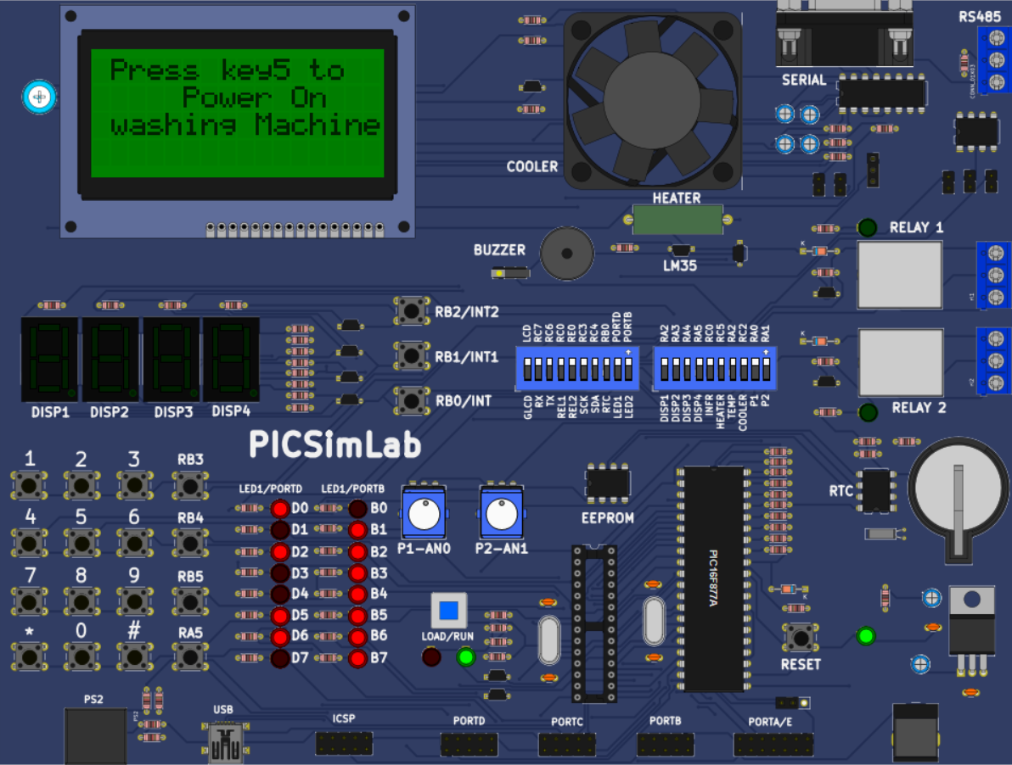
Emertxe Internship Project
Washing Machine Simulator using PIC Microcontroller
Presented by:
Venu Vaddimukkala
B. Tech 4th Year
Electronics and Communication Engineering
SR Gudlavalleru Engineering College

Slide 2
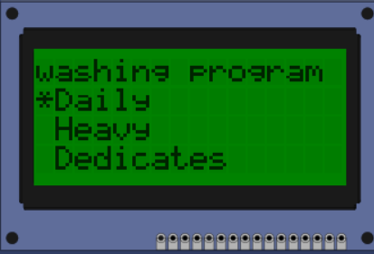
Project Objectives: Simulating a Smart Washing Experience
The primary goal of this project was to develop a comprehensive washing machine simulator that offers a realistic and interactive user experience. This involved several key objectives:
User-Interactive Interface: To create a responsive interface that allows users to easily interact with the simulated washing machine, mirroring the controls found on a typical appliance.
Wash Mode Selection: To implement functionality for selecting various wash modes (e.g., normal, delicate, heavy duty) via a keypad, providing flexibility in operation.
Water Level Control: To enable precise control over water levels through long key presses, simulating the adjustment of water volume for different load sizes.
CLCD Display: To utilise a Character Liquid Crystal Display (CLCD) to show the current operational status and the remaining time of the wash cycle, enhancing user feedback.
These objectives collectively aimed to build a robust and intuitive simulator, demonstrating practical embedded system design and programming skills. The project focused on integrating hardware and software components to achieve a seamless and functional simulation.
Safety Pause Feature: To incorporate a crucial safety mechanism that automatically pauses the washing operation when the lid is opened, preventing potential hazards during use.

Slide 3
Contents
1
Introduction to Embedded Systems
Understanding the foundational concepts of dedicated computing systems and their pervasive role in modern technology.
2
Embedded C Programming
Exploring the specific nuances of C programming tailored for direct hardware interaction and real-time operations.
3
PIC16F877A Microcontroller Overview
A detailed look at the core component of our simulator, its specifications, and capabilities.
4
Peripherals Used
An examination of the various hardware components integrated with the microcontroller to achieve the desired functionality.
5
Software Tools
Discussion of the development environments and tools essential for programming and simulating the system.
6
Functional Requirements
Outlining the specific operational features and user interactions that the simulator is designed to support.
7
Implementation Demo
A practical demonstration of the washing machine simulator in action, showcasing its interactive features.
8
Conclusion
Summarising the project's achievements, challenges, and potential for future enhancements.

Slide 4

Introduction to Embedded Systems:
Embedded systems are specialised computing systems designed to perform dedicated functions within a larger mechanical or electrical system. Unlike general-purpose computers, they are built for specific tasks, often with real-time constraints, ensuring operations are completed within defined timeframes.
Dedicated Functionality: Each embedded system is tailored to execute a particular set of tasks, optimising performance and resource usage for that specific purpose. This contrasts with personal computers that handle a wide array of applications.
Real-Time Operations: Many embedded systems operate in real-time environments, meaning they must respond to inputs and produce outputs within strict time limits. This is critical in applications like automotive control systems or medical devices where delays can have significant consequences.
The integration of embedded systems has revolutionised various industries by enhancing the functionality, reliability, and efficiency of countless products, making them an indispensable part of our technological landscape.
Ubiquitous Presence: Embedded systems are pervasive in modern life, found in a vast range of devices from household appliances like washing machines and microwaves, to complex systems in vehicles, industrial machinery, and advanced medical equipment.
Enhanced Efficiency and Reliability: By focusing on specific tasks, embedded systems can be highly optimised for power consumption, cost, and reliability. Their dedicated nature often leads to more robust and dependable performance compared to more flexible computing solutions.

Slide 5





Embedded C Programming: Bridging Software and Hardware
Lightweight C Variant
Embedded C is a subset of the C language, specifically designed for microcontroller programming. It is optimised for resource-constrained environments, making it ideal for systems with limited memory and processing power.
Direct Register Access
A key feature of Embedded C is its ability to directly access hardware registers. This allows programmers to manipulate peripheral components and control the microcontroller's behaviour at a very low level.
Fixed-Width Data Types
To ensure predictable behaviour and efficient memory usage, Embedded C often uses fixed-width data types (e.g., int8_t, uint16_t). This helps in managing memory precisely on embedded devices.
No Standard I/O Libraries
Unlike standard C, Embedded C typically lacks standard input/output libraries (like stdio.h) as it interacts directly with hardware. I/O operations are handled through custom drivers and register manipulation.
Crucial for Real-Time Operations
The direct hardware control and efficiency of Embedded C make it indispensable for real-time embedded operations, where precise timing and immediate responses are critical for system functionality.

Slide 6
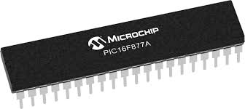
PIC16F877A Microcontroller: The Heart of the Simulator
8-bit MCU with 40 Pins: This microcontroller operates on an 8-bit architecture, providing a good balance of processing power and simplicity for embedded tasks. Its 40 pins offer ample input/output (I/O) capabilities for connecting various peripherals.
14.3 KB Flash Program Memory: The substantial Flash memory allows for the storage of complex program code, enabling the implementation of detailed washing machine logic and user interface routines.
5 MIPS CPU Speed: With a processing speed of 5 Million Instructions Per Second (MIPS), the PIC16F877A can execute commands rapidly, ensuring smooth and responsive operation of the simulator.
368B RAM and 256B EEPROM: The Random Access Memory (RAM) is used for temporary data storage during program execution, while the Electrically Erasable Programmable Read-Only Memory (EEPROM) provides non-volatile storage for configuration settings or user preferences.
Integrated Peripherals: It includes built-in timers (TMR0, TMR1, TMR2) for precise timing control, an Analog-to-Digital Converter (ADC) for reading analogue sensor inputs, and a Universal Synchronous Asynchronous Receiver Transmitter (USART) for serial communication.
The PIC16F877A is a popular 8-bit microcontroller from Microchip Technology, widely used in various embedded applications due to its versatility and robust feature set. It serves as the central processing unit for our washing machine simulator, orchestrating all operations.
Ideal for Embedded Simulations: Its comprehensive set of features, combined with its ease of use and widespread community support, makes the PIC16F877A an excellent choice for educational projects and embedded simulations like our washing machine model.

Slide 7












PIC16F877A Architecture Overview
GPIO (General Purpose Input/Output)
Timers (TMR0, TMR1, TMR2)
These pins are configurable as either inputs or outputs, allowing the microcontroller to interact with external devices like LEDs, keypads, and switches.
The PIC16F877A features multiple timers crucial for generating delays, counting events, and managing time-sensitive operations within the washing machine cycle.
LEDs & Buzzer
ADC (Analog-to-Digital Converter)
LEDs provide visual indicators for different modes or states, while the buzzer offers audible alerts for cycle completion or errors.
This module converts analogue signals from sensors (e.g., for water level detection) into digital values that the microcontroller can process.
CLCD (Character Liquid Crystal Display)
USART (Universal Synchronous Asynchronous Receiver Transmitter)
Used for displaying real-time information such as the current wash mode, remaining time, and operational status to the user.
Enables serial communication with other devices, useful for debugging or interfacing with more complex systems if needed.

Slide 8
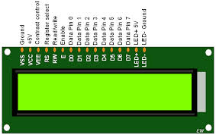
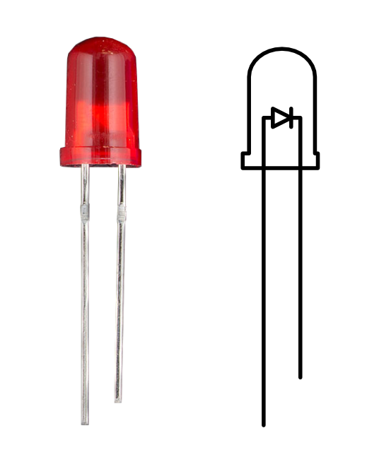
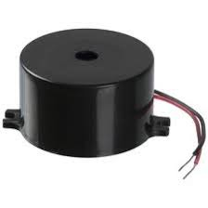
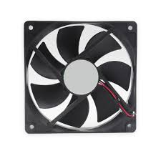
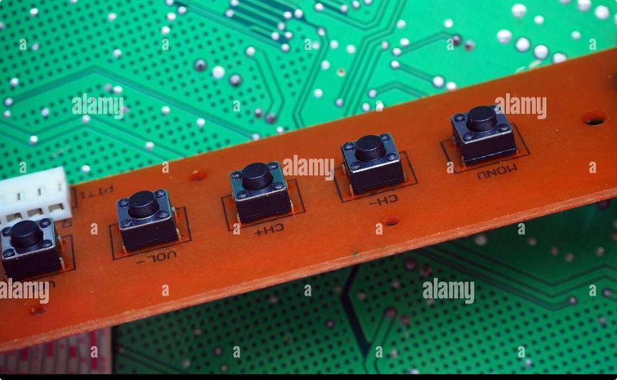
Peripheral Components: Bringing the Simulator to Life
CLCD (Character Liquid Crystal Display)
LED (Light Emitting Diode)
Buzzer
Fan (Simulated Motor)
The CLCD is essential for providing real-time feedback to the user, displaying the current operational status, selected wash mode, and the remaining time for the wash cycle.
LEDs serve as simple visual indicators, signifying power status, active wash modes, or other important states of the washing machine simulator.
The buzzer provides audible alerts and notifications, such as the completion of a wash cycle, an error condition, or confirmation of user input.
A small fan is used to simulate the rotation of the washing machine's drum, visually representing the active washing or spinning process.
Tactile Switches
These switches are crucial for user input, enabling selection of wash modes, pausing the operation, and simulating the lid open/close status for safety features.
These peripheral components are carefully integrated with the PIC16F877A microcontroller to create a comprehensive and interactive washing machine simulator, demonstrating practical application of embedded systems.

Slide 9
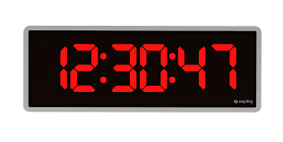
Timer Modules: The Heartbeat of Control
TMR0: 8-bit Basic Timer
TMR1: 16-bit Timer for Durations
TMR2: 8-bit with Prescaler/Postscaler
TMR0 serves as a fundamental 8-bit timer, primarily used for basic timing operations and generating precise delays within the system. Its simplicity makes it ideal for straightforward countdown mechanisms and event-driven timing.
TMR1 is a more robust 16-bit timer, specifically employed for managing longer durations and critical timing sequences. This module is crucial for accurately controlling the various stages of the washing cycle, ensuring each phase runs for the correct period.
TMR2 is an 8-bit timer enhanced with both prescaler and postscaler capabilities. This configuration allows for highly flexible timing, enabling precise control over countdowns and the timing of different operational modes, adapting to various washing program requirements.
These timer modules are integral to the washing machine's operation, providing the necessary temporal control for all functions, from the duration of washing cycles to the timing of specific actions like water filling or spinning.

Slide 10

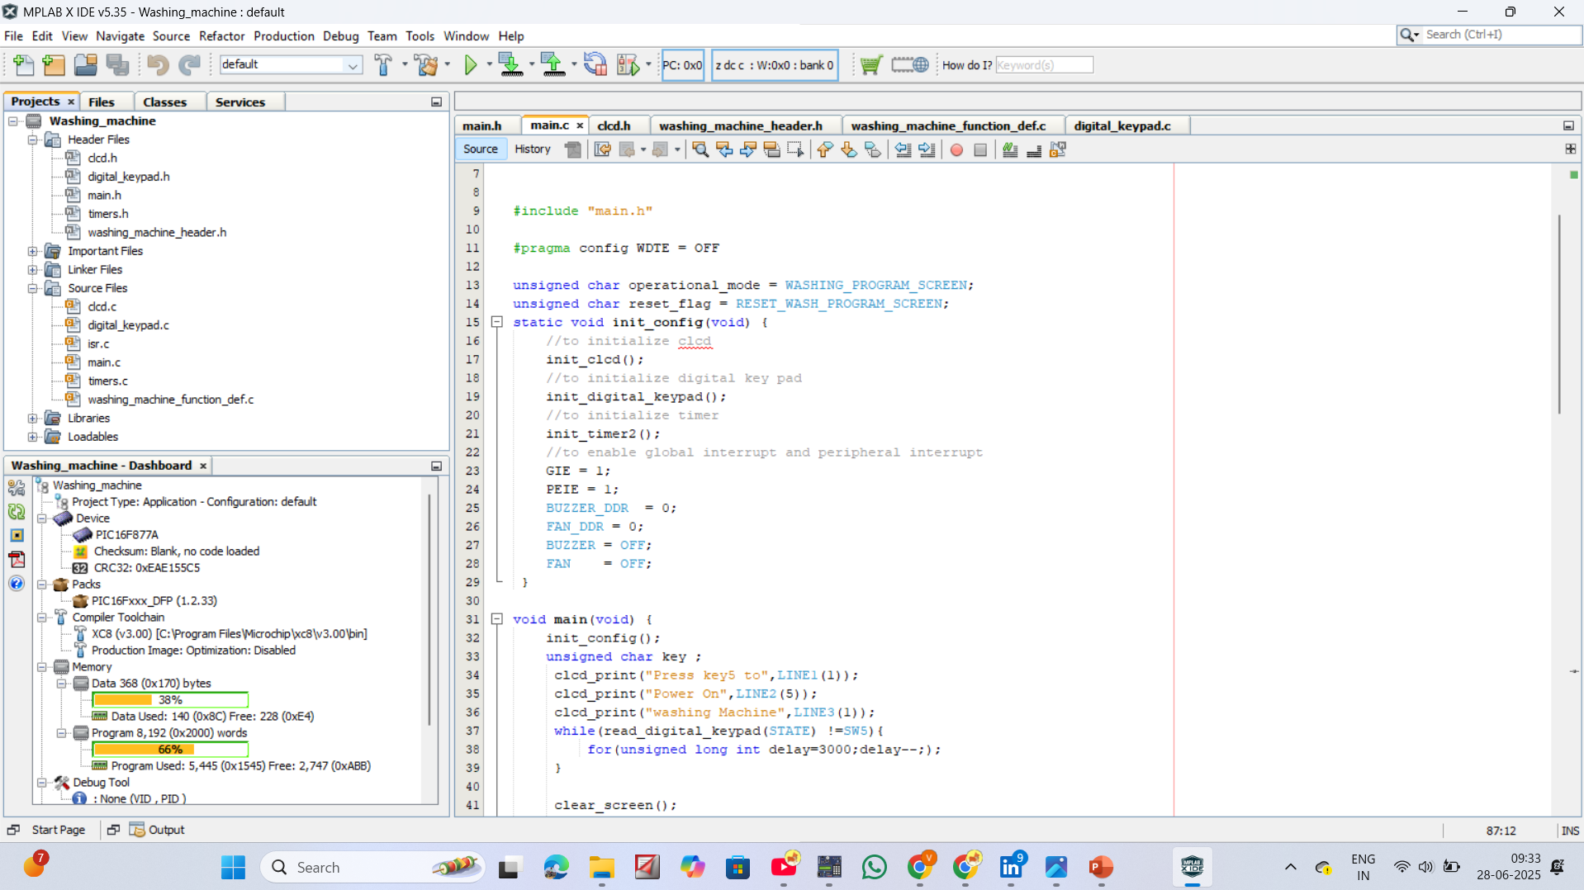


Software Tools:
MPLAB X IDE
MPLAB X IDE is the integrated development environment used for writing, compiling, and debugging the C code. It provides a comprehensive suite of tools essential for embedded software development, including project management, source code editing, and debugging functionalities.
XC8 Compiler
The XC8 Compiler is responsible for translating the C source code into machine-executable hex files. This crucial step converts the human-readable code into instructions that the PIC microcontroller can understand and execute, forming the core logic of the washing machine simulation.
The combination of these software tools creates a robust development ecosystem, enabling efficient code development, compilation, and realistic simulation of the washing machine's embedded system. This integrated approach ensures that the software logic functions as intended before deployment on actual hardware.
PICSimLab
PICSimLab provides a virtual simulation environment for the hardware components. This tool allows for thorough testing and validation of the embedded system's logic without the need for physical hardware, significantly accelerating the development and debugging process.

Slide 11
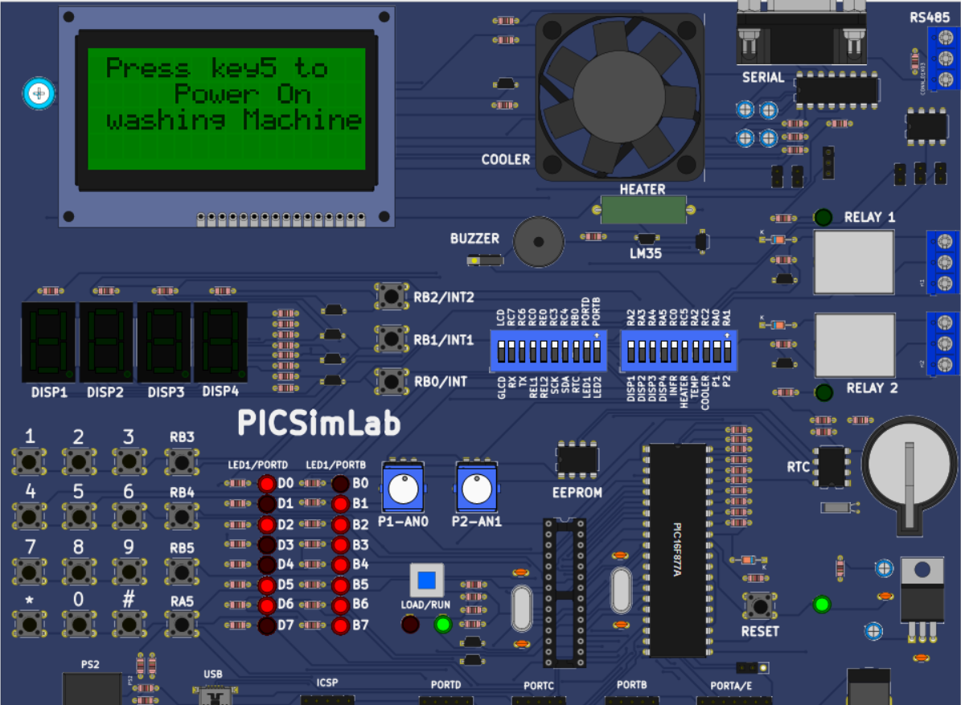
Functional Requirements: User Interaction and Display
SW5: Power ON / Start
This switch initiates the washing machine operation, powering on the system and starting the selected washing program. It acts as the primary control for beginning a cycle.
SW6: Pause / Stop
SW6 provides control over the ongoing washing cycle, allowing users to pause the operation or completely stop the program. This is essential for user intervention during a cycle.
SW4: Scroll & Select
This multi-functional switch enables navigation through menu options and selection of desired settings, such as washing modes and water levels. It is crucial for user input and configuration.
SW1: Lid Open Detection
SW1 simulates the lid open sensor, a critical safety feature. When activated, it halts the washing machine's operation to prevent accidents, ensuring user safety.
CLCD: Display Mode, Function, Time
The Character Liquid Crystal Display (CLCD) provides real-time feedback to the user, showing the current washing mode, active function, and remaining time. It is the primary visual interface.
Buzzer: Alerts on Events
The buzzer provides audible alerts for various events, such as program completion, errors, or when a user action is required. It enhances the user experience through auditory feedback.

Slide 12
Washing Modes and User Flow: Customising the Wash
Washing Options
The washing machine offers a variety of washing options to cater to different fabric types and cleaning needs. These include common modes such as Daily, Heavy, and Whites, each pre-configured with specific wash cycles and durations.
Water Levels
Users can select from various water levels, including Auto, Low, Medium, and High. The 'Auto' setting intelligently adjusts the water level based on the load size, while manual options provide greater control for specific washing requirements.
Selection Mechanism
Both the washing mode and water level are selected via a long key press on the designated control switch (SW4). This intuitive interface allows users to cycle through options and confirm their selection.
Timer Activation
Once a washing program is selected and initiated, the internal timer commences. This marks the beginning of the automated washing cycle, with the system managing all subsequent operations based on the chosen mode.

Slide 13
Display Screens & Feedback: Keeping the User Informed
1
Initial Prompt
Upon powering on, the CLCD displays a clear initial prompt: "Press SW5 to Start". This guides the user on how to begin interacting with the washing machine.
2
Washing Mode Selection
After the initial prompt, the display transitions to the washing mode selection menu. Users can scroll through options like "Daily," "Heavy," and "Whites" to choose the appropriate cycle for their laundry.
3
Water Level Selection
Following mode selection, the display presents options for water level adjustment. Users can select "Auto," "Low," "Medium," or "High" to optimise water usage based on the load size.
4
Timer & Function Display
Once the program begins, the CLCD continuously updates to show the remaining time for the current cycle and the active function (e.g., "Washing," "Rinsing," "Spinning"). This real-time feedback keeps the user informed of the machine's progress.
5
Completion Message
Upon successful completion of the washing cycle, the display shows a "Remove Clothes" message, indicating that the laundry is ready. This clear instruction ensures a smooth user experience.
The detailed display screens and feedback mechanisms ensure that users are always aware of the washing machine's status and can easily navigate through its functions.

Slide 14
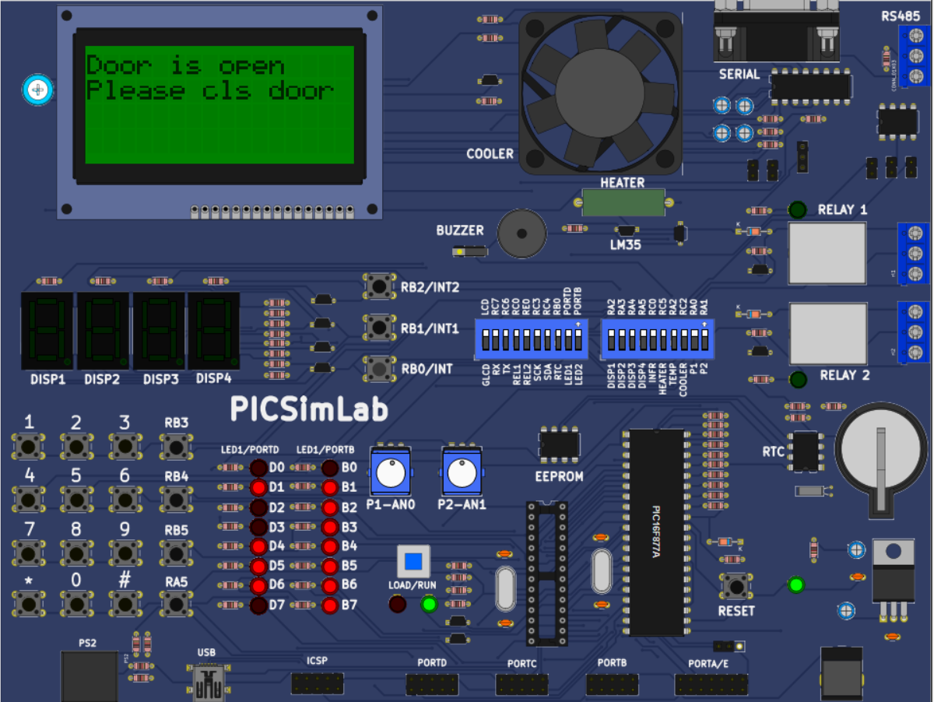
Pause & Safety Feature: Ensuring Control and Security
SW6: Pause Functionality
The SW6 button provides a crucial pause functionality during the washing cycle. When pressed, the timer halts, and any active components like the fan (simulating the drum) stop their operation. This allows users to temporarily interrupt the cycle for various reasons, such as adding forgotten items or checking the laundry.
SW5: Resume Operation
To resume the washing cycle after a pause, the SW5 button is pressed. This continues the program from where it left off, ensuring a seamless continuation of the wash without needing to restart the entire cycle.
SW1: Door Open Sensor Simulation
SW1 simulates the essential door open sensor, a vital safety feature. If the lid is detected as open during operation, the system immediately halts all processes. This prevents potential accidents and ensures the safety of the user, especially when the machine is in motion.
These features highlight the robust control and safety mechanisms integrated into the washing machine simulation, providing both user convenience and protection.

Slide 15
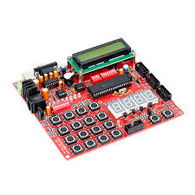
Conclusion & Acknowledgments: Key Learnings and Future Confidence
Realistic Simulation Achieved
The project successfully created a realistic simulation of a washing machine, accurately replicating its operational cycles and user interactions. This demonstrates the effectiveness of embedded system design in mimicking real-world appliances.
Fully User-Controlled Interface
A key outcome was the development of a fully user-controlled interface, allowing for intuitive selection of modes, water levels, and real-time monitoring of the washing process.
Real-Time Embedded Logic Implementation
The project provided invaluable experience in implementing real-time embedded logic, crucial for managing concurrent tasks and precise timing in microcontroller-based systems.
Simulation Replaces Physical Hardware
Utilising PICSimLab, the project successfully demonstrated that complex embedded systems can be thoroughly developed and tested through simulation, significantly reducing the need for expensive physical hardware during the development phase.
This project was successfully completed at Emertxe Technologies, where we gained practical knowledge of embedded systems and developed confidence in C programming and hardware logic. Thank you for your attention!

